Slide 1
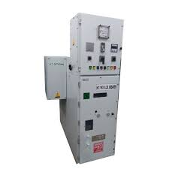
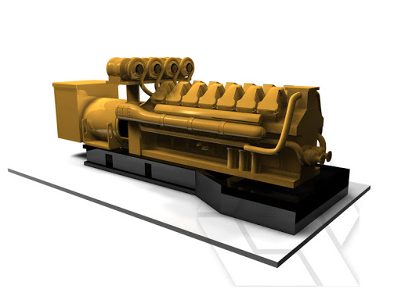
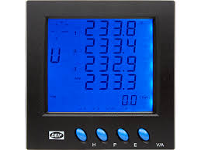
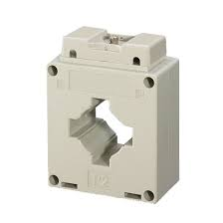
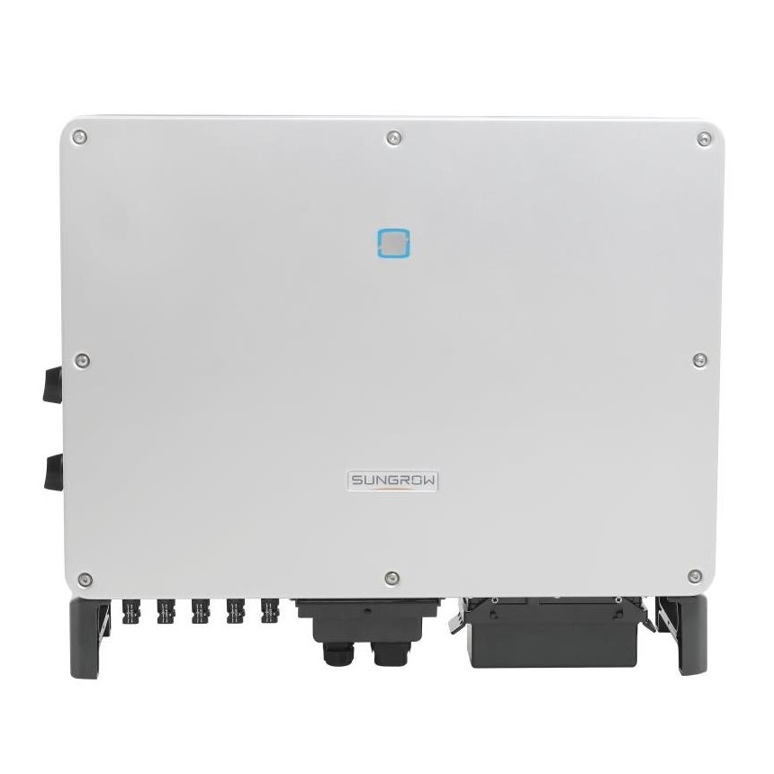
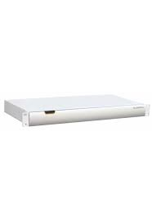
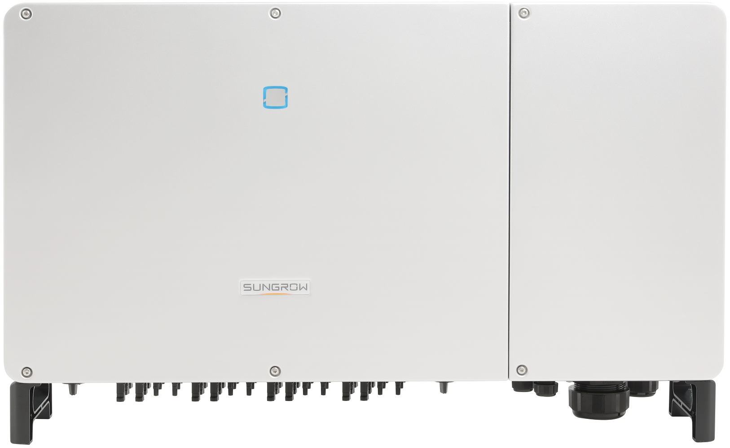
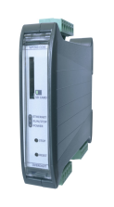
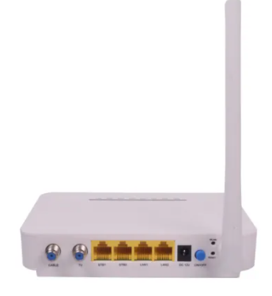

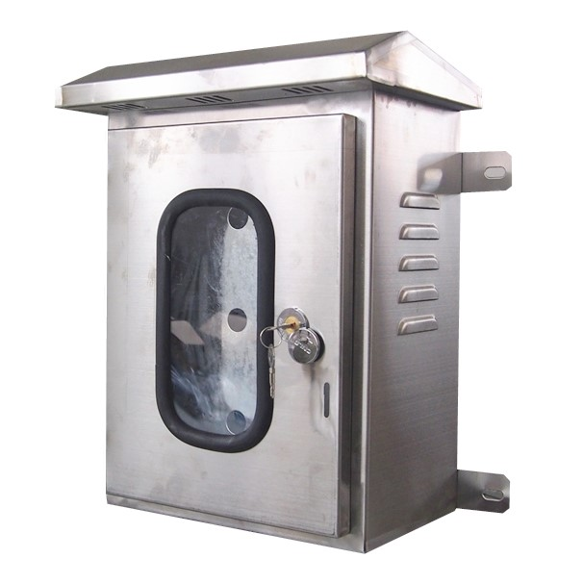
Hi-Tech Control System
Legends
RS-485 Protocol
TCP-IP
CAT 6
HT Panel
Genset 1
Genset 2
Genset 3
Energy
Analyzer
Energy
Analyzer
Energy
Analyzer
Client’s 3xCTs
Energy
Analyzer
Datalogger
PV Controller
Inverter 7
Inverter 8 (33kW)
Switch
Inverter 6
Inverter 5
Inverter 4
Internet
Inverter 1
Inverter 2
Inverter 3
EMS DB

